Slide 1
Coffee Shop Sales Analysis
DR. Rakhee Chhibber

Slide 2
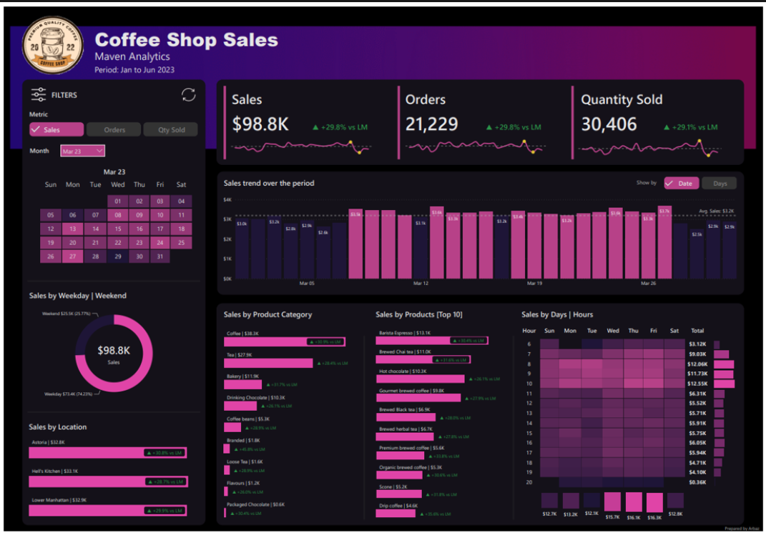

Slide 3
Coffee Shop Sales Performance Dashboard
It tells the story of:
  Total Sales performance
  Number of Orders
  Quantity Sold
  Daily sales trend
  Best-selling products
  Best product categories
  Busy sales hours
  Weekday vs Weekend performance
  Location-wise sales
  Monthly filtering and interactive analysis

Slide 4
Dashboard layout
Section | Purpose
KPI Cards | Total Sales, Orders, Quantity Sold
Date Filter | Select month
Trend Chart | Sales trend over time
Donut Chart | Weekday vs Weekend sales
Bar Charts | Product category sales
Top Products | Best performing products
Heatmap | Sales by Day and Hour
Location Sales | Store-wise sales
Interactive Filters | Cross filtering

Slide 5
Dataset Required
CoffeeSalesData
ProductDimension
DateDimension

Slide 6
CoffeeSalesData
TransactionID | Date | Time | StoreLocation | ProductCategory | ProductName | Quantity | UnitPrice
1001 | 01-01-2023 | 08:15 | Astoria | Coffee | Barista Espresso | 2 | 5
1002 | 01-01-2023 | 09:10 | Hell's Kitchen | Tea | Brewed Chai Tea | 1 | 4
1003 | 01-01-2023 | 10:22 | Lower Manhattan | Bakery | Croissant | 3 | 3
1004 | 01-01-2023 | 11:05 | Astoria | Drinking Chocolate | Hot Chocolate | 2 | 6
1005 | 01-01-2023 | 12:45 | Lower Manhattan | Coffee | Brewed Black Tea | 1 | 4

Slide 7
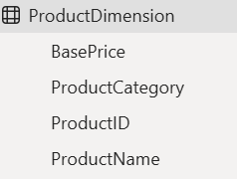
ProductDimension
ProductName
Barista Espresso
Brewed Chai Tea
Hot Chocolate
Gourmet Brewed Coffee
Brewed Black Tea
Organic Brewed Coffee
Premium Brewed Coffee
Scone
Drip Coffee
Latte
Cappuccino
ProductCategory
Coffee
Tea
Bakery
Drinking Chocolate
Coffee Beans
Branded
Loose Tea
Flavours
Packaged Chocolate

Slide 8
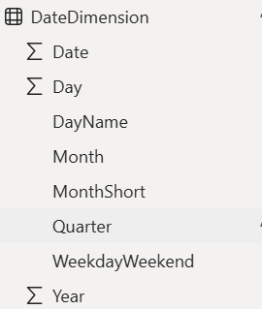
DateDimension

Slide 9
Agenda
Growth strategy
Market analysis
Financial overview
Innovative solutions
Future initiatives

Slide 10
Strategies for growth
Navigating the future

Slide 11
Current market analysis
We have identified important key trends that demand our attention.
Data reveals a steady increase in consumer demand for sustainable products, presenting an opportunity for our eco-friendly offerings.
Our competitors are now focusing on digital marketing strategies, suggesting a shift in consumer behavior.
Understanding these nuanced dynamics positions us to adapt and capitalize on emerging market preferences.

Slide 12

Market expansion
Unlocking new horizons

Slide 13
Product launch
Q3
Market research
Q4
Product development
Q1
User testing
Q2
Product launch
Currently gearing up for
a ground-breaking launch
Our new offerings will captivate the market
Our marketing campaign will generate anticipation

Slide 14

Marketing strategies
Implement personalized engagement strategies
Tailor campaigns to resonate with specific demographics, fostering a sense of relevance and connection
Collaborate with influencers and thought leaders to amplify our brand message

Slide 15
Financial overview
Our financial overview reflects a robust and resilient fiscal performance.
Key indicators show consistent revenue growth over the past quarter, attributed to strategic cost management and successful marketing.
Operating margins have improved, signaling operational efficiency, while strengthening our reserves.
This underscores our commitment to financial stability, positioning us for sustained growth.

Slide 16
Innovative decisions

Slide 17
Quarterly targets
Quarter | Revenue growth (%) | Market share increase (%) | Customer acquisition
Q1 | 12 | 2 | 500
Q2 | 15 | 3 | 600
Q3 | 18 | 4 | 700
Q4 | 20 | 5 | 800
Market expansion
Product innovation
Customer retention
Operational efficiency

Slide 18
Financial snapshot
Metric | Current value | Previous quarter | Change (%)
Revenue | $2,500,000 | $2,200,000 | +14%
Operating expenses | $1,200,000 | $1,400,000 | -14%
Net profit | $1,000,000 | $800,000 | +25%
Operating margin | 40% | 36% | +4%
Cash reserves | $5,000,000 | $4,500,000 | +11%

Slide 19
Innovative solutions

Slide 20
Future initiatives
Green supply chain
Reduced carbon footprint
Waste reduction
Water conservation
Product enhancement.
  Introduce regular updates and features to enhance product offerings.
Technology integration.
  Explore emerging technologies for potential integration into our operations.
Collaborative partnerships.
  Foster collaborations with tech innovators and industry leaders to drive innovation.

Slide 21
Thank You
Mirjam Nilsson
mirjam@contoso.com
www.contoso.com

